Slide 1
Topological Sort

Slide 2
Definition: DAG
A Directed Acyclic Graph often abbreviated DAG
DAGs used in many applications to indicate precedence among events.
If DFS of a directed graph yields no back edges, then the graph contains no cycles
A
D
A
D
B
B
G
G
F
C
E
F
C
E
This graph has more than one cycle.
Can you find them all?
This graph has no cycles, so it is a DAG.

Slide 3
Definition: Topological Sort
A topological sort of a DAG G = (V, E) is a linear ordering of all its vertices such that if G contains an edge (u, v), then u appears before v in the ordering.
If the graph is cyclic, then no linear ordering is possible.
A topological sort of a graph can be viewed as an ordering of its vertices along a horizontal line so that all directed edges go from left to right.
Topological sorting is thus different from the usual kind of "sorting" .

Slide 4
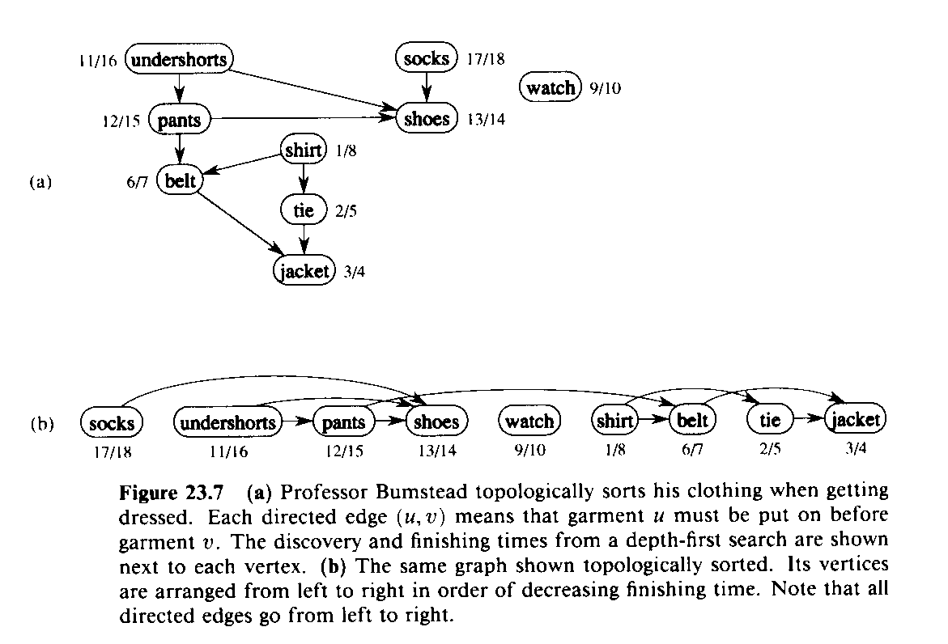
Topological Sort
for Directed, Acyclic Graph (DAG)
G=(V,E)
TOPOLOGICAL-SORT(G)
1 DFS(G) computes “finishing times” for each vertex
2 as each vertex is finished, insert it onto front of list
3 return list
Produces linear ordering of vertices.
For edge (u,v), u is ordered before v.

Slide 5
Topological Sort
The following algorithm topologically sorts a DAG:
TOPOLOGICAL-SORT(G)
call DFS(G) to compute finishing times f[v] for each vertex v (this is equal to the order in which vertices change color from gray to black)
as each vertex is finished (turns black), insert it onto the front of a linked list
return the linked list of vertices

Slide 6
Example
Vertices are added to front of a linked list in the blackening order.
Final result is shown below
Note that all tree edges and non-tree edges point to the right
T
C
T
T
C
T
G
E
D
C
A
B
C
F
T
C
F

Slide 7
Topological Sort
We can perform a topological sort in time Θ(V + E), since depth-first search takes Θ(V + E) time and it takes 0(1) time to insert each of the |V| vertices onto the front of the linked list.

Slide 8
Topological Sort: DFS
C
G
A
B
D
E
F
H

Slide 9
Topological Sort: DFS
C
dfs(A)
G
A
B
D
E
F
H

Slide 10
Topological Sort: DFS
C
dfs(A)
dfs(D)
G
A
B
D
E
F
H

Slide 11
Topological Sort: DFS
C
dfs(A)
dfs(D)
dfs(E)
G
A
B
D
E
F
H

Slide 12
Topological Sort: DFS
C
dfs(A)
dfs(D)
dfs(E)
dfs(F)
G
A
B
D
E
F
H

Slide 13
Topological Sort: DFS
C
dfs(A)
dfs(D)
dfs(E)
dfs(F)
dfs(H)
G
A
B
D
E
F
H

Slide 14
Topological Sort: DFS
C
dfs(A)
dfs(D)
dfs(E)
dfs(F)
G
A
B
D
E
F
H
7

Slide 15
Topological Sort: DFS
C
dfs(A)
dfs(D)
dfs(E)
G
A
B
D
E
F
6
H
7

Slide 16
Topological Sort: DFS
C
dfs(A)
dfs(D)
G
A
B
D
E
5
F
6
H
7

Slide 17
Topological Sort: DFS
C
dfs(A)
dfs(D)
G
A
B
D
E
5
F
6
H
7

Slide 18
Topological Sort: DFS
C
dfs(A)
G
A
B
D
E
4
5
F
6
H
7

Slide 19
Topological Sort: DFS
C
dfs(A)
G
A
B
D
E
4
5
F
6
H
7

Slide 20
Topological Sort: DFS
C
G
A
3
B
D
E
4
5
F
6
H
7

Slide 21
Topological Sort: DFS
C
dfs(B)
G
A
3
B
D
E
4
5
F
6
H
7

Slide 22
Topological Sort: DFS
C
dfs(B)
G
A
3
B
D
E
4
5
F
6
H
7

Slide 23
Topological Sort: DFS
C
G
A
3
B
2
D
E
4
5
F
6
H
7

Slide 24
Topological Sort: DFS
C
dfs(C)
G
A
3
B
2
D
E
4
5
F
6
H
7

Slide 25
Topological Sort: DFS
C
dfs(C)
G
A
3
B
2
D
E
4
5
F
6
H
7

Slide 26
Topological Sort: DFS
C
dfs(C)
G
A
3
B
2
D
E
4
5
F
6
H
7

Slide 27
Topological Sort: DFS
C
dfs(C)
G
A
3
B
2
D
E
4
5
F
6
H
7

Slide 28
Topological Sort: DFS
C
dfs(C)
dfs(G)
G
A
3
B
2
D
E
4
5
F
6
H
7

Slide 29
Topological Sort: DFS
C
dfs(C)
G
1
A
3
B
2
D
E
4
5
F
6
H
7

Slide 30
Topological Sort: DFS
0
C
G
1
A
3
B
2
D
E
4
5
F
6
H
7

Slide 31
Topological Sort: DFS
0
C
G
1
A
3
B
2
D
E
4
5
F
6
H
7
Topological order: C G B A D E F H

Slide 32
Minimum Spanning Trees

Slide 33
Spanning Tree
Assume you have an undirected graph G = (V,E)
Spanning tree of graph G is tree T = (V,E_{T} E, R)
Tree has same set of nodes
All tree edges are graph edges
Root of tree is R
Think: “smallest set of edges needed to connect everything together”

Slide 34
Spanning trees
1
0
A
B
A
1
B
2
9
G
G
5
2
F
3
7
8
F
C
C
I
H
I
H
6
D
E
4
D
E
Breadth-first Spanning Tree
Depth-first spanning tree

Slide 35
Property 1 of spanning trees
Graph: G = (V,E) , Spanning tree: T = (V,E_{T},R)
For any edge c in G but not in T, there is a simple cycle containing only edge c and edges in spanning tree.
edge (I,H):
simple cycle is (I,H,G,I)
edge (H,C):
simple cycle is (H,C,B,A,G,H)
A
B
G
F
C
I
H
E
D

Slide 36
Property 2 of spanning trees
Graph: G = (V,E), Spanning tree: T = (V,E_{T},R)
For any edge c in G but not in T, there is a simple cycle Y containing only edge c and edges in spanning tree.
Moreover, inserting edge c into T and deleting any edge in Y gives another spanning tree T’.
A
B
edge (H,C):
simple cycle is (H,C,B,A,G,H)
adding (H,C) to T and deleting (A,B)
gives another spanning tree
G
F
C
I
H
E
D

Slide 37
Building BFS/DFS spanning trees
Use sequence structure as before, but put/get edges, not nodes
Get edge (s,d) from structure
If d is not in done set,
add d to done set
(s,d) is in spanning tree
add out-edges (d,t) to seq structure if t is not in done set
Example: BFS (Queue)
dummy
1
0
A
B
2
G
F
C
I
H
E
D
[(dummy,A)]
[(A,B),(A,G),(A,F)]…..

Slide 38
Weighted Spanning Trees
Assume you have an undirected graph G = (V,E) with weights on each edge
Spanning tree of graph G is tree T = (V,E_{T} E)
Tree has same set of nodes
All tree edges are graph edges
Weight of spanning tree = sum of tree edge weights

Slide 39
Example
A
2
B
9
5
G
6
4
F
1
2
5
5
C
6
3
I
4
H
1
2
E
1
D
Graph
A
2
B
9
5
G
6
4
F
1
2
5
5
C
MST
6
3
I
4
H
1
2
E
1
D

Slide 40
Property 3
2
9
5
G
4
Edge(G→H): 5
Cycle edges: (G→I), (I→E),
(E→D),(H→D) all have weights
less than (G→H)
6
F
1
2
5
5
C
6
3
I
4
H
1
2
E
1
D
Graph: G = (V,E) , Spanning tree: T = (V,E_{T},R)
For any edge: c in G but not in T, there is a simple cycle Y containing only edge c and edges in spanning tree (already proved).
Moreover, weight of c must be greater than or equal to weight of any edge in this cycle.

Slide 41
Building MSTs
Prim’s algorithm:
Kruskal’s algorithm:

Slide 42
Kruskal's Algorithm
This algorithm creates a forest of trees. Initially the forest consists of n single node trees (and no edges). At each step, we add one edge (the cheapest one) so that it joins two trees together. If it were to form a cycle, it would simply link two nodes that were already part of a single connected tree, so that this edge would not be needed.

Slide 43
The steps are:
1. The forest is constructed - with each node in a separate tree.
2. The edges are placed in a queue.
3. Until we've added n-1 edges,
1. Extract the cheapest edge from the queue,
2. If it forms a cycle, reject it,
3. Else add it to the forest. Adding it to the forest will join two trees together.
Every step will have joined two trees in the forest together, so that at the end, there will only be one tree in T.

Slide 44
Complete Graph
B
4
C
4
2
1
A
4
E
1
F
D
2
3
10
G
5
5
6
3
4
I
H
2
3
J

Slide 45
A
4
B
A
1
D
B
4
C
B
4
D
B
4
C
B
10
J
C
2
E
4
2
1
C
1
F
D
5
H
A
4
E
1
F
2
D
6
J
E
2
G
D
3
10
G
5
F
3
G
F
5
I
5
6
3
4
I
G
3
I
G
4
J
H
2
3
J
H
2
J
I
3
J

Slide 46
Sort Edges
(in reality they are placed in a priority queue - not sorted - but sorting them makes the algorithm easier to visualize)
1
1
A
D
C
F
C
2
E
E
2
G
B
4
C
H
2
J
F
3
G
4
2
1
G
3
I
I
3
J
A
4
E
1
F
2
A
4
B
B
4
D
D
3
10
G
5
B
4
C
G
4
J
5
6
3
4
I
F
5
I
D
5
H
H
2
3
J
D
6
J
B
10
J

Slide 47
Add Edge
1
1
A
D
C
F
C
2
E
E
2
G
B
4
C
H
2
J
F
3
G
4
2
1
G
3
I
I
3
J
A
4
E
1
F
2
A
4
B
B
4
D
D
3
10
G
5
B
4
C
G
4
J
5
6
3
4
I
F
5
I
D
5
H
H
2
3
J
D
6
J
B
10
J

Slide 48
Add Edge
1
1
A
D
C
F
C
2
E
E
2
G
B
4
C
H
2
J
F
3
G
4
2
1
G
3
I
I
3
J
A
4
E
1
F
2
A
4
B
B
4
D
D
3
10
G
5
B
4
C
G
4
J
5
6
3
4
I
F
5
I
D
5
H
H
2
3
J
D
6
J
B
10
J

Slide 49
Add Edge
1
1
A
D
C
F
C
2
E
E
2
G
B
4
C
H
2
J
F
3
G
4
2
1
G
3
I
I
3
J
A
4
E
1
F
2
A
4
B
B
4
D
D
3
10
G
5
B
4
C
G
4
J
5
6
3
4
I
F
5
I
D
5
H
H
2
3
J
D
6
J
B
10
J

Slide 50
Add Edge
1
1
A
D
C
F
C
2
E
E
2
G
B
4
C
H
2
J
F
3
G
4
2
1
G
3
I
I
3
J
A
4
E
1
F
2
A
4
B
B
4
D
D
3
10
G
5
B
4
C
G
4
J
5
6
3
4
I
F
5
I
D
5
H
H
2
3
J
D
6
J
B
10
J

Slide 51
Add Edge
1
1
A
D
C
F
C
2
E
E
2
G
B
4
C
H
2
J
F
3
G
4
2
1
G
3
I
I
3
J
A
4
E
1
F
2
A
4
B
B
4
D
D
3
10
G
5
B
4
C
G
4
J
5
6
3
4
I
F
5
I
D
5
H
H
2
3
J
D
6
J
B
10
J

Slide 52
Cycle
Don’t Add Edge
1
1
A
D
C
F
C
2
E
E
2
G
B
4
C
H
2
J
F
3
G
4
2
1
G
3
I
I
3
J
A
4
E
1
F
2
A
4
B
B
4
D
D
3
10
G
5
B
4
C
G
4
J
5
6
3
4
I
F
5
I
D
5
H
H
2
3
J
D
6
J
B
10
J

Slide 53
Add Edge
1
1
A
D
C
F
C
2
E
E
2
G
B
4
C
H
2
J
F
3
G
4
2
1
G
3
I
I
3
J
A
4
E
1
F
2
A
4
B
B
4
D
D
3
10
G
5
B
4
C
G
4
J
5
6
3
4
I
F
5
I
D
5
H
H
2
3
J
D
6
J
B
10
J

Slide 54
Add Edge
1
1
A
D
C
F
C
2
E
E
2
G
B
4
C
H
2
J
F
3
G
4
2
1
G
3
I
I
3
J
A
4
E
1
F
2
A
4
B
B
4
D
D
3
10
G
5
B
4
C
G
4
J
5
6
3
4
I
F
5
I
D
5
H
H
2
3
J
D
6
J
B
10
J

Slide 55
Add Edge
1
1
A
D
C
F
C
2
E
E
2
G
B
4
C
H
2
J
F
3
G
4
2
1
G
3
I
I
3
J
A
4
E
1
F
2
A
4
B
B
4
D
D
3
10
G
5
B
4
C
G
4
J
5
6
3
4
I
F
5
I
D
5
H
H
2
3
J
D
6
J
B
10
J

Slide 56
Cycle
Don’t Add Edge
1
1
A
D
C
F
C
2
E
E
2
G
B
4
C
H
2
J
F
3
G
4
2
1
G
3
I
I
3
J
A
4
E
1
F
2
A
4
B
B
4
D
D
3
10
G
5
B
4
C
G
4
J
5
6
3
4
I
F
5
I
D
5
H
H
2
3
J
D
6
J
B
10
J

Slide 57
Add Edge
1
1
A
D
C
F
C
2
E
E
2
G
B
4
C
H
2
J
F
3
G
4
2
1
G
3
I
I
3
J
A
4
E
1
F
2
A
4
B
B
4
D
D
3
10
G
5
B
4
C
G
4
J
5
6
3
4
I
F
5
I
D
5
H
H
2
3
J
D
6
J
B
10
J

Slide 58
Minimum Spanning Tree
Complete Graph
B
4
C
4
B
C
4
4
2
1
2
1
A
E
A
4
1
F
E
F
1
D
2
2
D
3
10
G
G
5
3
5
6
3
4
I
I
H
H
2
3
3
J
2
J

Slide 59
Analysis of Kruskal's Algorithm
Running Time = O(m log n) (m = edges, n = nodes)
Testing if an edge creates a cycle can be slow.
It usually only has to check a small fraction of the edges, but in some cases (like if there was a vertex connected to the graph by only one edge and it was the longest edge) it would have to check all the edges.
This algorithm works best, of course, if the number of edges is kept to a minimum.

Slide 60
Prim's Algorithm
This algorithm starts with one node. It then, one by one, adds a node that is unconnected to the new graph, each time selecting the node whose connecting edge has the smallest weight out of the available nodes’ connecting edges.

Slide 61
The steps are:
1. The new graph is constructed - with one node from the old graph.
2. While new graph has fewer than n nodes,
1. Find the node from the old graph with the smallest
connecting edge to the new graph,
2. Add it to the new graph
Every step will have joined one node, so that at the end we will have one graph with all the nodes and it will be a minimum spanning tree of the original graph.

Slide 62
The algorithm starts with a tree consisting of a single vertex, and continuously increases its size one edge at a time, until it spans all vertices.
Input: A non-empty connected weighted graph with vertices V and edges E.
Initialize: V_{new} = {x}, where x is an arbitrary node (starting point) from V, E_{new} = {}
Repeat until V_{new} = V:
Choose an edge {u, v} with minimal weight such that u is in V_{new} and v is not (if there are multiple edges with the same weight, any of them may be picked)
Add v to V_{new}, and {u, v} to E_{new}
Output: V_{new} and E_{new} describe a minimal spanning tree

Slide 63
Complete Graph
B
4
C
4
2
1
A
4
E
1
F
D
2
3
10
G
5
5
6
3
4
I
H
2
3
J

Slide 64
Old Graph
New Graph
B
4
C
4
B
4
C
2
1
4
2
1
A
4
E
1
F
A
4
E
F
1
D
2
3
10
D
2
3
G
5
10
G
5
5
6
3
5
6
3
4
I
4
H
I
3
H
2
J
2
3
J

Slide 65
Old Graph
New Graph
B
4
C
4
B
4
C
2
1
4
2
1
A
4
E
1
F
A
4
E
F
1
D
2
3
10
D
2
3
G
5
10
G
5
5
6
3
5
6
3
4
I
4
H
I
3
H
2
J
2
3
J

Slide 66
Old Graph
New Graph
B
4
C
4
B
4
C
2
1
4
2
1
A
4
E
1
F
A
4
E
F
1
D
2
3
10
D
2
3
G
5
10
G
5
5
6
3
5
6
3
4
I
4
H
I
3
H
2
J
2
3
J

Slide 67
Old Graph
New Graph
B
4
C
4
B
4
C
2
1
4
2
1
A
4
E
1
F
A
4
E
F
1
D
2
3
10
D
2
3
G
5
10
G
5
5
6
3
5
6
3
4
I
4
H
I
3
H
2
J
2
3
J

Slide 68
Old Graph
New Graph
B
4
C
4
B
4
C
2
1
4
2
1
A
4
E
1
F
A
4
E
F
1
D
2
3
10
D
2
3
G
5
10
G
5
5
6
3
5
6
3
4
I
4
H
I
3
H
2
J
2
3
J

Slide 69
Old Graph
New Graph
B
4
C
4
B
4
C
2
1
4
2
1
A
4
E
1
F
A
4
E
F
1
D
2
3
10
D
2
3
G
5
10
G
5
5
6
3
5
6
3
4
I
4
H
I
3
H
2
J
2
3
J

Slide 70
Old Graph
New Graph
B
4
C
4
B
4
C
2
1
4
2
1
A
4
E
1
F
A
4
E
F
1
D
2
3
10
D
2
3
G
5
10
G
5
5
6
3
5
6
3
4
I
4
H
I
3
H
2
J
2
3
J

Slide 71
Old Graph
New Graph
B
4
C
4
B
4
C
2
1
4
2
1
A
4
E
1
F
A
4
E
F
1
D
2
3
10
D
2
3
G
5
10
G
5
5
6
3
5
6
3
4
I
4
H
I
3
H
2
J
2
3
J

Slide 72
Old Graph
New Graph
B
4
C
4
B
4
C
2
1
4
2
1
A
4
E
1
F
A
4
E
F
1
D
2
3
10
D
2
3
G
5
10
G
5
5
6
3
5
6
3
4
I
4
H
I
3
H
2
J
2
3
J

Slide 73
Old Graph
New Graph
B
4
C
4
B
4
C
2
1
4
2
1
A
4
E
1
F
A
4
E
F
1
D
2
3
10
D
2
3
G
5
10
G
5
5
6
3
5
6
3
4
I
4
H
I
3
H
2
J
2
3
J

Slide 74
Complete Graph
Minimum Spanning Tree
B
4
C
4
B
4
C
2
1
4
2
1
A
4
E
1
F
A
E
F
1
D
2
3
10
D
2
G
5
G
5
6
3
3
4
I
H
I
3
H
2
J
2
3
J

Slide 75
Analysis of Prim's Algorithm
Running Time = O(m + n log n) (m = edges, n = nodes)
Unlike Kruskal’s, it doesn’t need to see all of the graph at once. It can deal with it one piece at a time.
For this algorithm the number of nodes needs to be kept to a minimum in addition to the number of edges. For small graphs, the edges matter more, while for large graphs the number of nodes matters more.

